Slide 1
Introduction
The biplotEZ package aims to provide users with EZier software to construct biplots.
What is a biplot?
Visualisation of multi-dimensional data in 2 or 3 dimensions.
A brief history of biplots and biplotEZ …

Slide 2
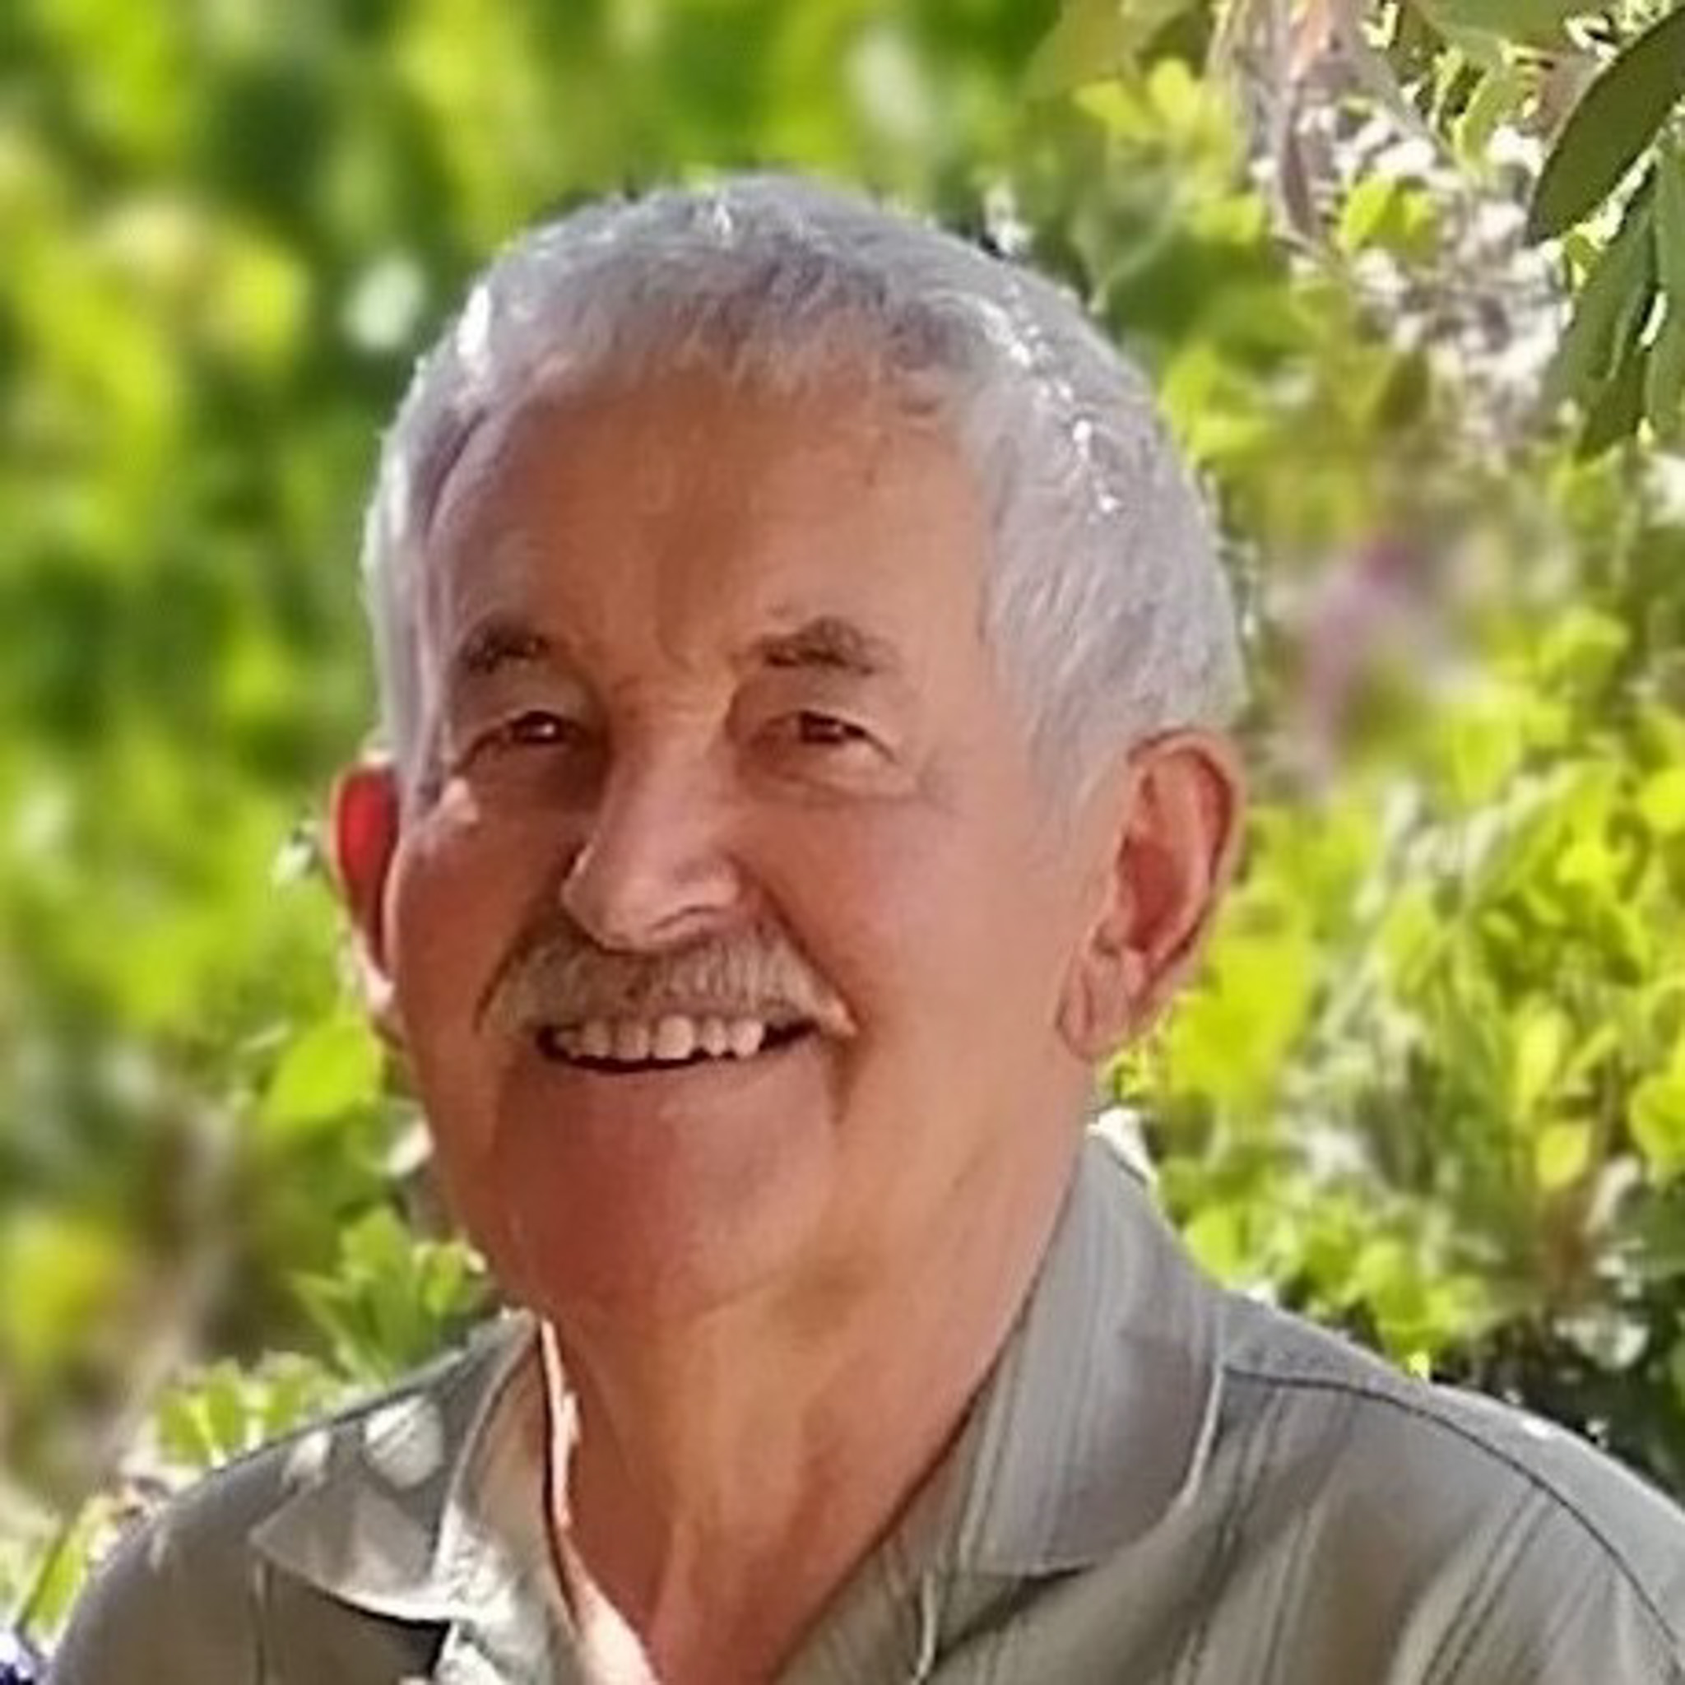
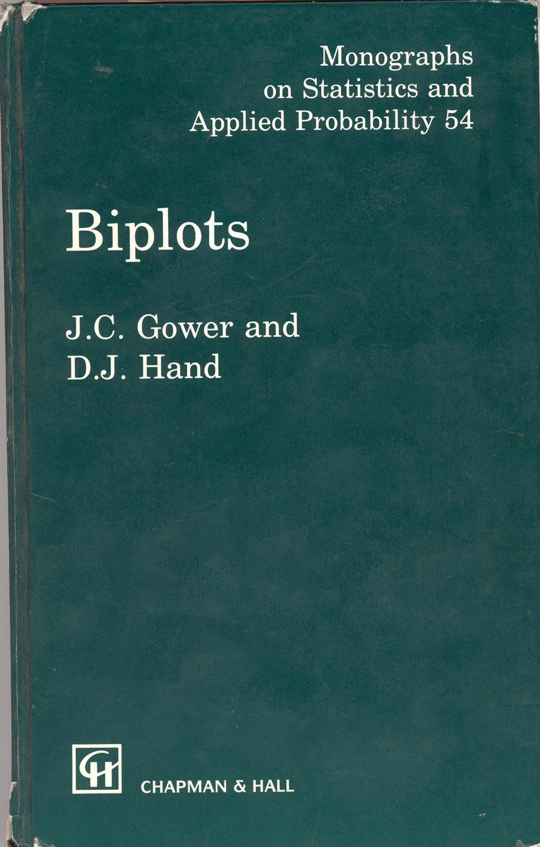
History (1)
1971
Gabriel, K.R., The biplot graphic display of matrices with application to principal component analysis. Biometrika, 58(3), pp.453-467.
1976
Prof Niël J le Roux presents a seminar on biplots.
1996
John Gower publish Biplots with David Hand.
Prof le Roux introduces a Masters module on Biplots (Multidimensional scaling).
Rika Cilliers obtains her Masters on biplots for socio-economic progress under Prof le Roux.

Slide 3

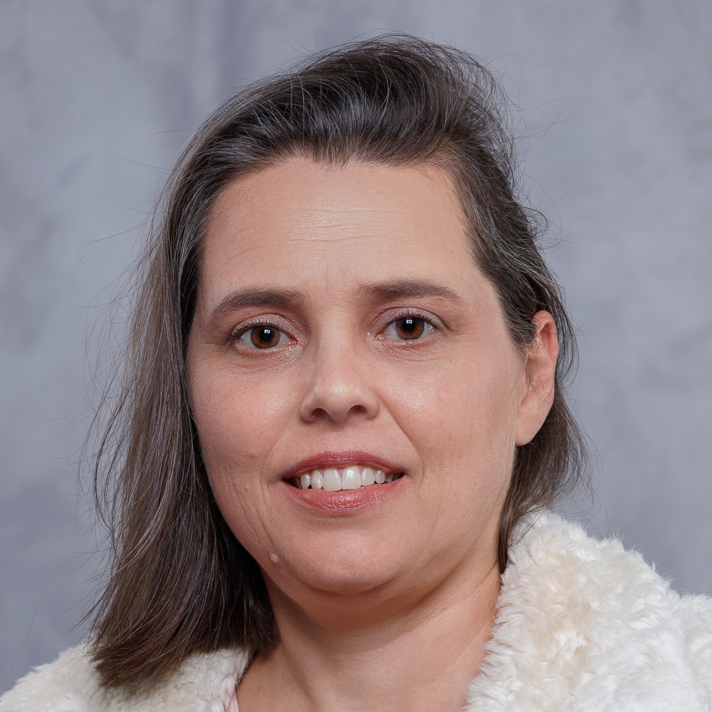
History (2)
1997
SASA conference paper: S-PLUS FUNCTIONS FOR INTERACTIVE LINEAR ANDD NON-LINEAR BIPLOTS by SP van Blerk, NJ le Roux & S Gardner.
2001
Sugnet Gardner (Lubbe) obtains her PhD on biplots under Prof le Roux.
Louise Wood obtains her Masters on biplots for socio-economic development under Prof le Roux.
2003
Adele Bothma obtains her Masters on biplots for school results under Prof le Roux.
2007
Idele Walters obtains her Masters on biplots for exploring the gender gap under Prof le Roux.

Slide 4
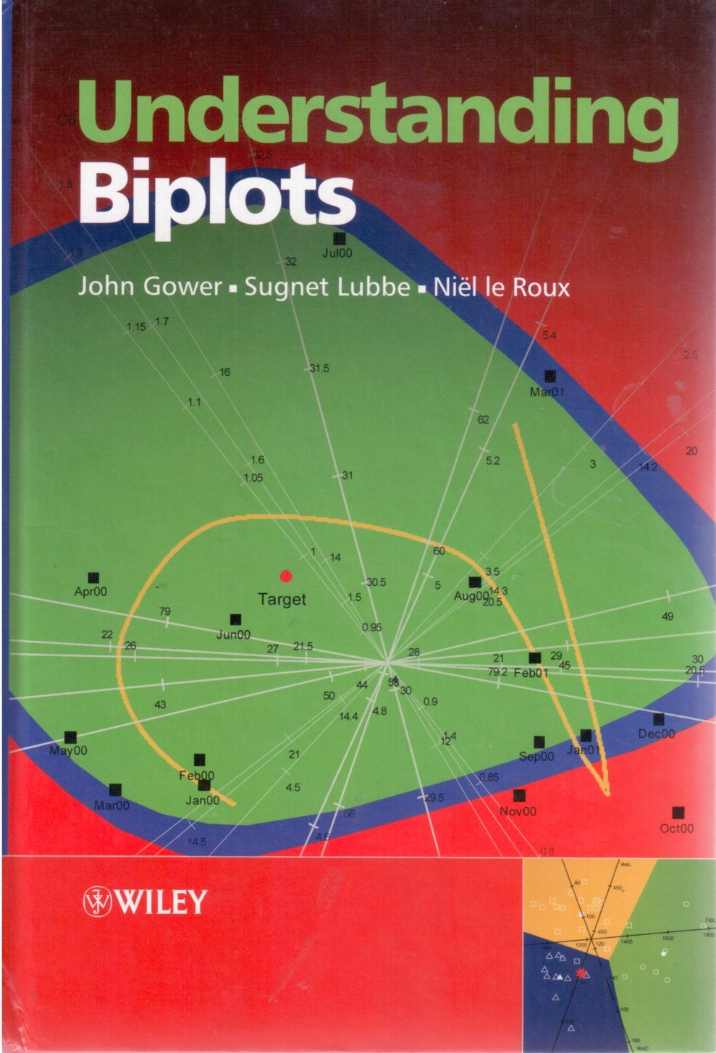
History (3)
2008
Ryan Wedlake obtains his Masters on robust biplots under Prof le Roux.
2009
BiplotGUI for Interactive Biplots, Anthony la Grange.
2010
André Mostert obtains his Masters on biplots in industry under Prof le Roux.
2011
John Gower, Sugnet Lubbe and Niël le Roux publish Understanding Biplots.
R package UBbipl developed with the book, but never published.

Slide 5
History (4)
2013
Hilmarie Brand obtains her Masters on PCA and CVA biplots under Prof le Roux.
2014
Opeoluwa Oyedele obtains her PhD on Partial Least Squares biplots under Sugnet Lubbe.
2015
Ruan Rossouw obtains his PhD on using biplots for multivariate process monitoring under Prof le Roux.
2016
Ben Gurr obtains his Masters on biplots for crime data under Prof le Roux.

Slide 6
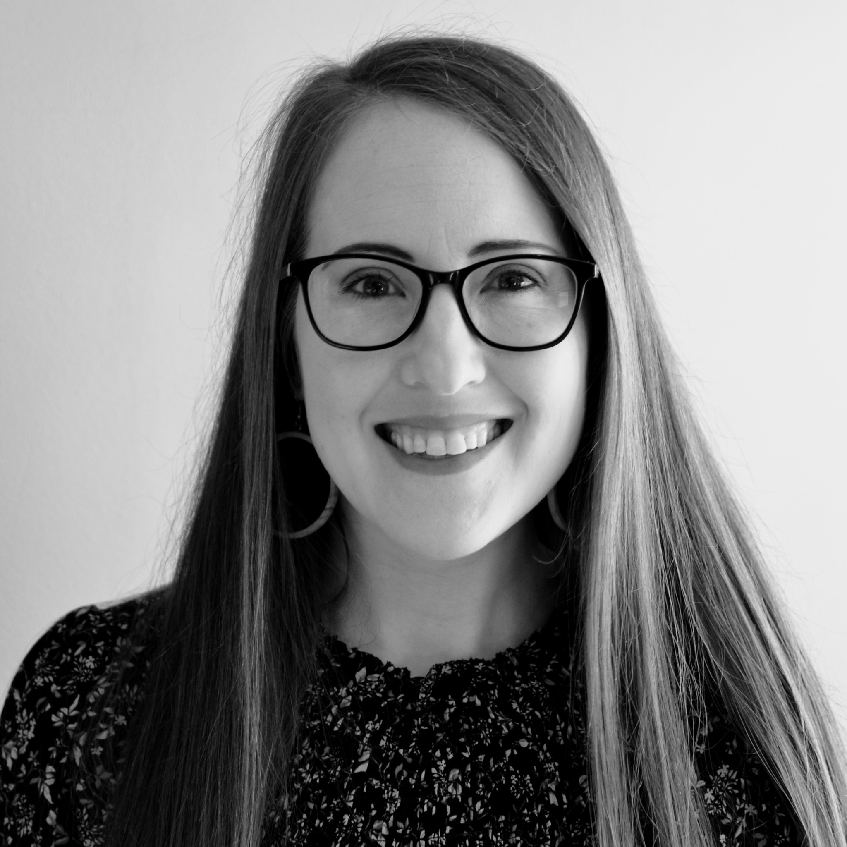
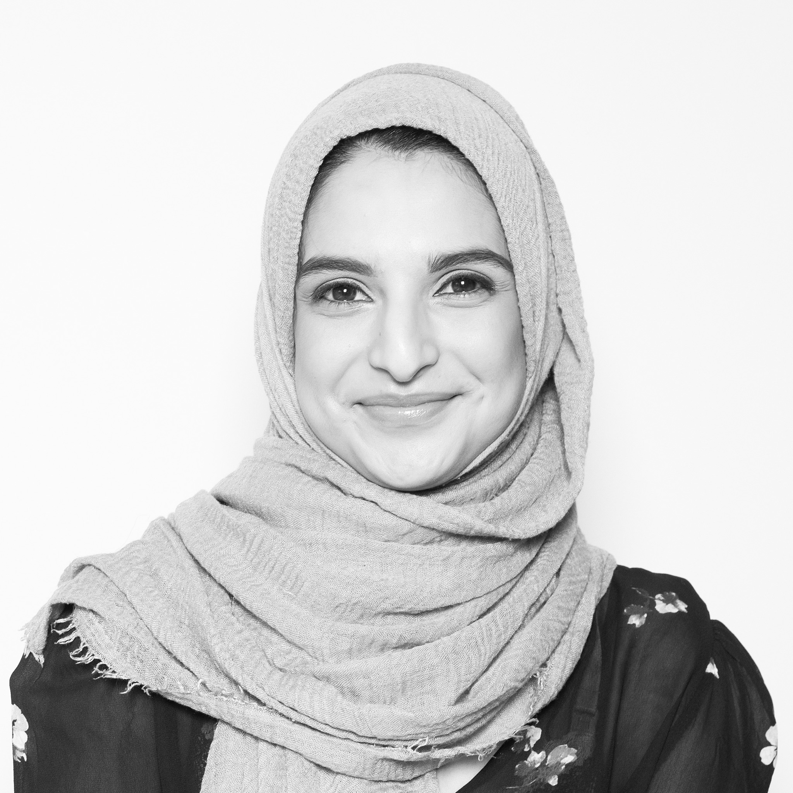
History (4)
2019
Johané Nienkemper-Swanepoel obtains her PhD on MCA biplots under Prof le Roux and Sugnet Lubbe.
Carel van der Merwe obtains his PhD using biplots.
Carel supervises 4 Master’s projects on biplots.
Justin Perrang, Francesca van Niekerk, David Rodwell, Delia Sandilands.
2020
Raeesa Ganey obtains her PhD on Principal Surface biplots under Sugnet Lubbe.
André Mostert obtains his PhD on multidimensional scaling for identification of contributions to out-of-control multivariate processes under Sugnet Lubbe.
Adriaan Rowen obtains his Masters using biplots to understand black-box machine learning models.

Slide 7
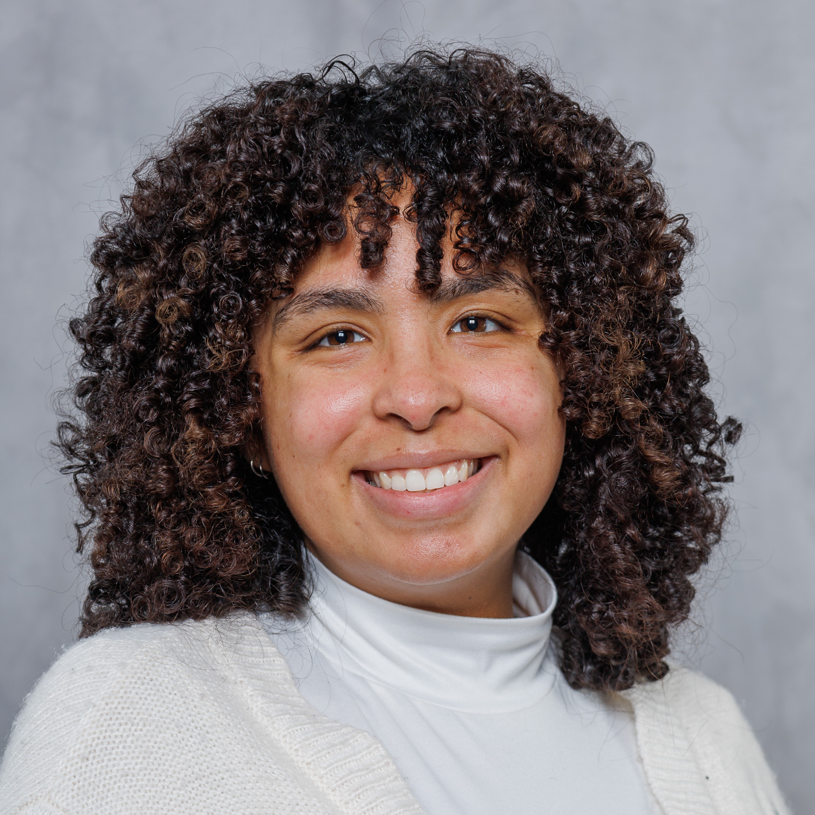
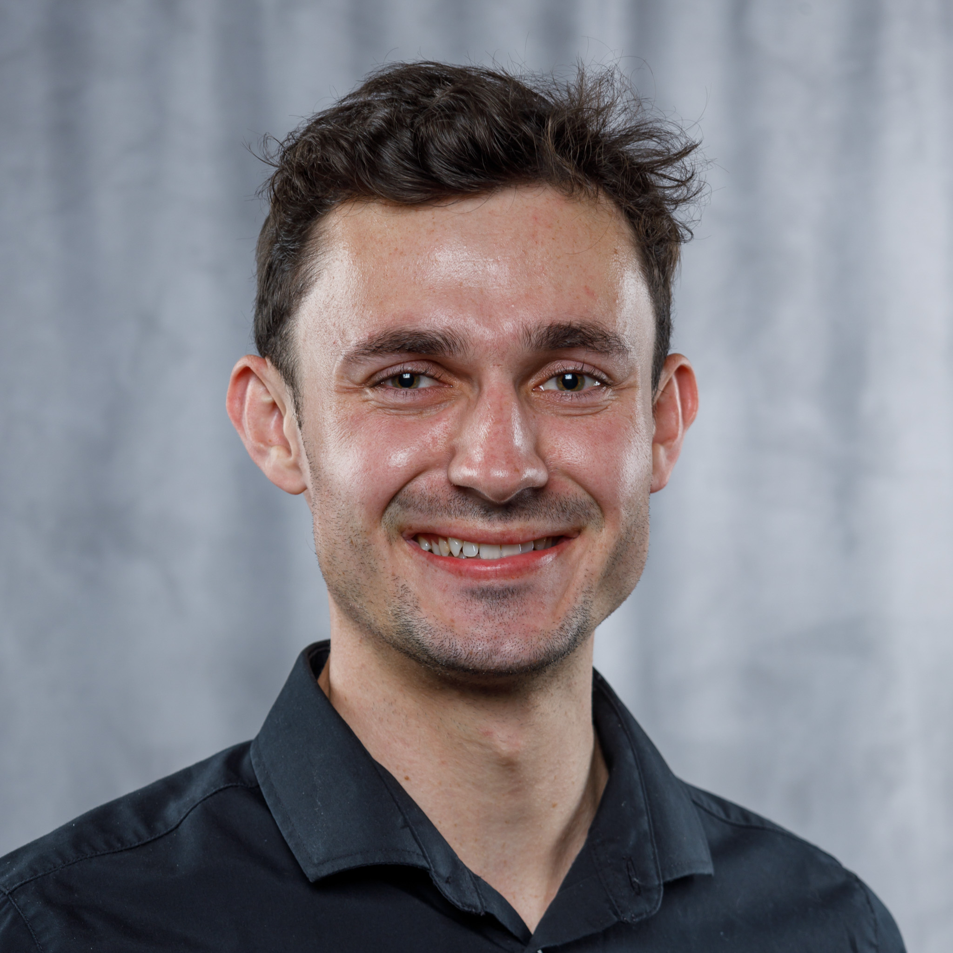
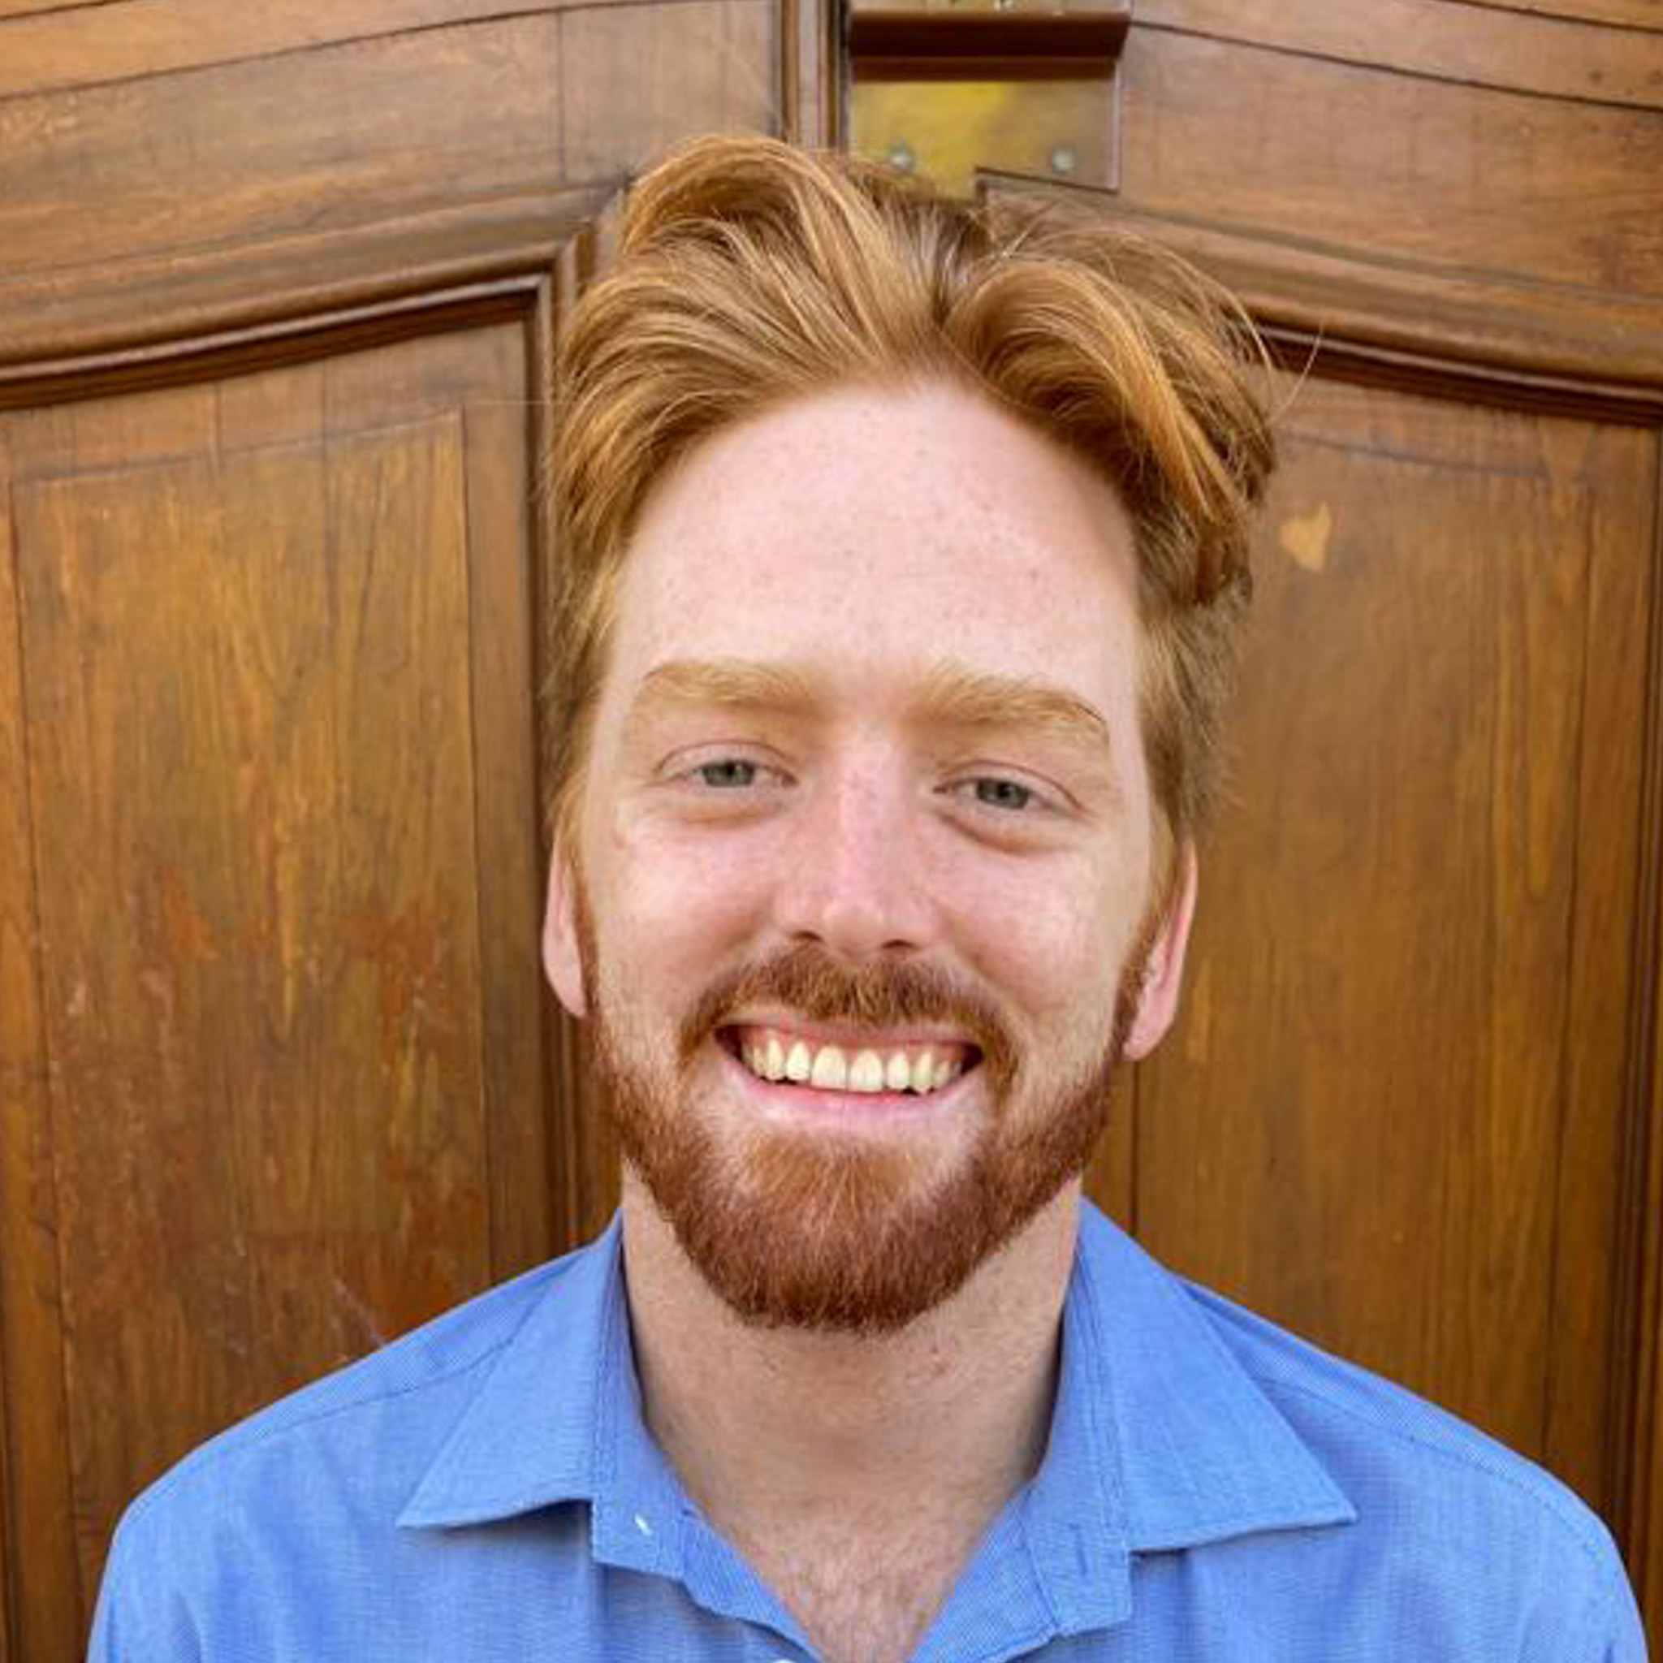
History (5)
2022
Zoë-Mae Adams obtains her Masters on biplots in sentiment classification under Johané Nienkemper-Swanepoel.
2023
bipl5 for Exploding Biplots, Ruan Buys.
2024
Ruan Buys obtains his Masters on Exploding biplots under Carel van der Merwe.
Adriaan Rowen to submit his PhD using biplots to understand black-box machine learning models.
Peter Manefeldt to submit his Masters using multidimensional scaling for interpretability of random forest models.

Slide 8
The Team

